Slide 1
ACACES 2018 Summer School GPU Architectures: Basic to Advanced Concepts
Adwait Jog, Assistant Professor
College of William & Mary (http://adwaitjog.github.io/)

Slide 2
Course Outline
Lectures 1 and 2: Basics Concepts
Basics of GPU Programming
Basics of GPU Architecture
Lecture 3: GPU Performance Bottlenecks
Memory Bottlenecks
Compute Bottlenecks
Possible Software and Hardware Solutions
Lecture 4: GPU Security Concerns
Timing channels
Possible Software and Hardware Solutions

Slide 3
Era of Heterogeneous Architectures
Intel Coffee Lake and
Kaby Lake
AMD Raven Ridge

Slide 4
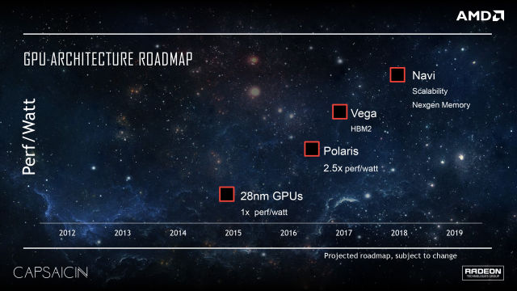
Discrete GPUs

Slide 5
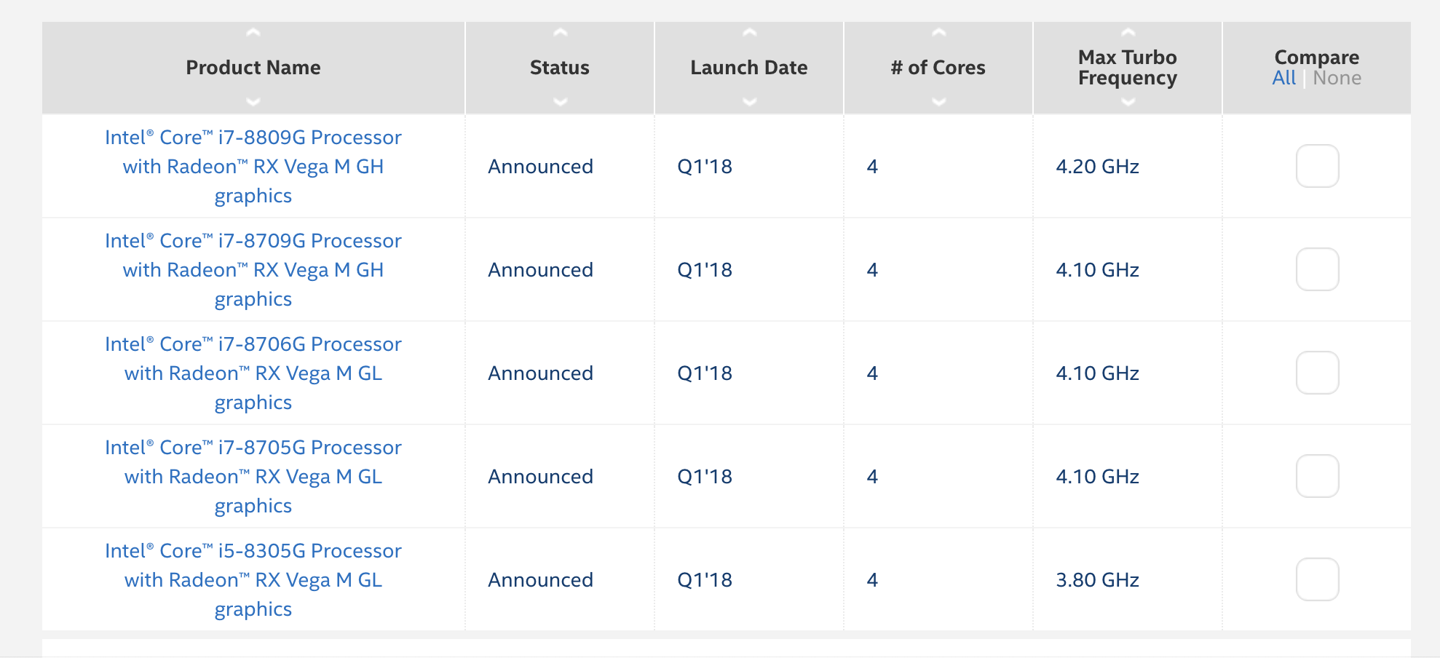
Discrete GPUs + Intel Processors

Slide 6
Security Concerns
GPUs may be accelerating applications that are using user-sensitive data (e.g., genomics, financial)
GPUs may be accelerating cryptographic applications (e.g., AES, RSA etc.) and authentication algorithms on-behalf of CPUs
Given the popularity of GPUs, it is imperative to keep GPUs secure against a variety of side-channel attacks and other security vulnerabilities.

Slide 7
Security Attacks
User’s web activity on GPU can be tracked by the malicious attacker who is co-located on the same card [Oakland’14]
AES private keys can be recovered by correlation timing attacks [HPCA’16]
Accelerating attacks via GPUs [Oakland’18]
Glitch: Accelerating row hammer attacks

Slide 8








Correlation Timing Attacks
Server@GPU
Plaintexts | Ciphertexts | Time duration
Plaintext # 1
Ciphertext # 1
time₁
Plaintext # 2
Ciphertext # 2
time₂
Plaintext # 3
Ciphertext # 3
time₃
…
…
…
Correct Key??
Correct Key
K₁ , K₂ , … ,
, …
K_{i}
Outside Attacker
time_{start}
- time_{stop} = time₁
Key guesses
Notes:
This should be a general timing attack description

Slide 9
Memory Access Coalescing in GPUs
Computing Unit
Wavefront pool
Wavefront
Thread # 1
. . .
Thread # 32
Scheduler
LD/ST Unit
Coalescing Unit
Global Memory

Slide 10
Memory Access Coalescing in GPUs
Wavefront
tid = thread id
tid = 0
tid = 1
tid = 2
tid = 3
0x00
0x04
0x07
0x09
Block Address # 0
0x00
0x01
0x02
0x03
Block Address # 1
0x04
0x05
0x06
0x07
Block Address # 1
0x04
0x05
0x06
0x07
Block Address # 2
0x08
0x09
0x0A
0x0B

Slide 11
Memory Access Coalescing in GPUs
Wavefront
tid = thread id
tid = 0
tid = 1
tid = 2
tid = 3
0x00
0x04
0x07
0x09
Coalescing Unit
Block Address # 0
0x00
0x01
0x02
0x03
Block Address # 1
0x04
0x05
0x06
0x07
Block Address # 2
0x08
0x09
0x0A
0x0B

Slide 12
AES implementation on GPU
Symmetric Encryption with 128-bit key and 10 rounds.
S-box implementation involves table lookups.
[Jiang/Fei/Kaeli, HPCA’16] demonstrated that the last round is vulnerable.

Slide 13
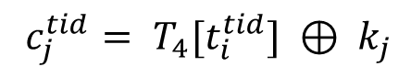
Last Round of AES on GPU
$c_{j}^{tid}= T_{4}[t_{i}^{tid}] ⊕ k_{j}$

Slide 14
Last Round of AES on GPU
$c_{j}^{tid}= T_{4}[t_{i}^{tid}] ⊕ k_{j}$
t_{i}¹
Thread # 1
T₄[t_{i}¹]
Request # 1
Replies # 1
⊕k_{j}
c_{j}¹
LINE # 1
LINE # 2
Thread # 2
T₄[t_{i}²]
Request # 2
Replies # 2
⊕k_{j}
t_{i}²
c_{j}²
.
.
.
.
.
.
.
.
.
.
.
.
.
.
.
.
.
.
.
.
.
.
.
.
…
…
Coalescing
Unit
…
…
LINE # 32
Thread # 32
T₄[t_{i}³²]
Request # 32
Replies # 32
⊕k_{j}
t_{i}³²
c_{j}³²
Input text
to Last Round
Ciphertext

Slide 15
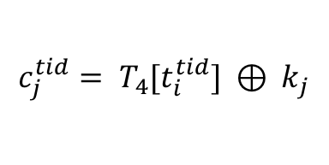
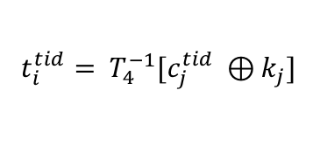
Correlation Timing Attack on GPU
Goal of the attack: Recover the AES Key (byte-by-byte)
Last Round of AES is vulnerable
Last Round is invertible
$$c_{j}^{tid}= T_{4}[t_{i}^{tid}] ⊕ k_{j}$$
Memory access
of thread tid
$t_{i}^{tid}= T_{4}^{−1}[c_{j}^{tid} ⊕k_{j}]$
How an attacker can calculate the number of coalesced accesses?
Notes:
After the goal, Attack model – using figure slide 2. What is available to the attacker – ciphertext, execution time and AES Tables.

Slide 16
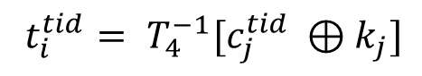
Attacker calculates the # of coalesced accesses
$t_{i}^{tid}= T_{4}^{−1}[c_{j}^{tid} ⊕k_{j}]$
Guessed Table
Lookup Indices
c_{j}¹
⊕k_{j}^{m}
T₄⁻¹[c_{j}¹⊕k_{j}^{m}]
t_{i}^{1,m}
c_{j}²
⊕k_{j}^{m}
T₄⁻¹[c_{j}²⊕k_{j}^{m}]
t_{i}^{2,m}
Correct value of key byte?
.
.
.
.
.
.
.
.
.
.
.
.
.
.
.
.
.
.
.
.
.
…
…
Coalesced Accesses
(A_{j}^{m,n})
c_{j}³²
⊕k_{j}^{m}
T₄⁻¹[c_{j}³²⊕k_{j}^{m}]
t_{i}^{32,m}
Ciphertext

Slide 17
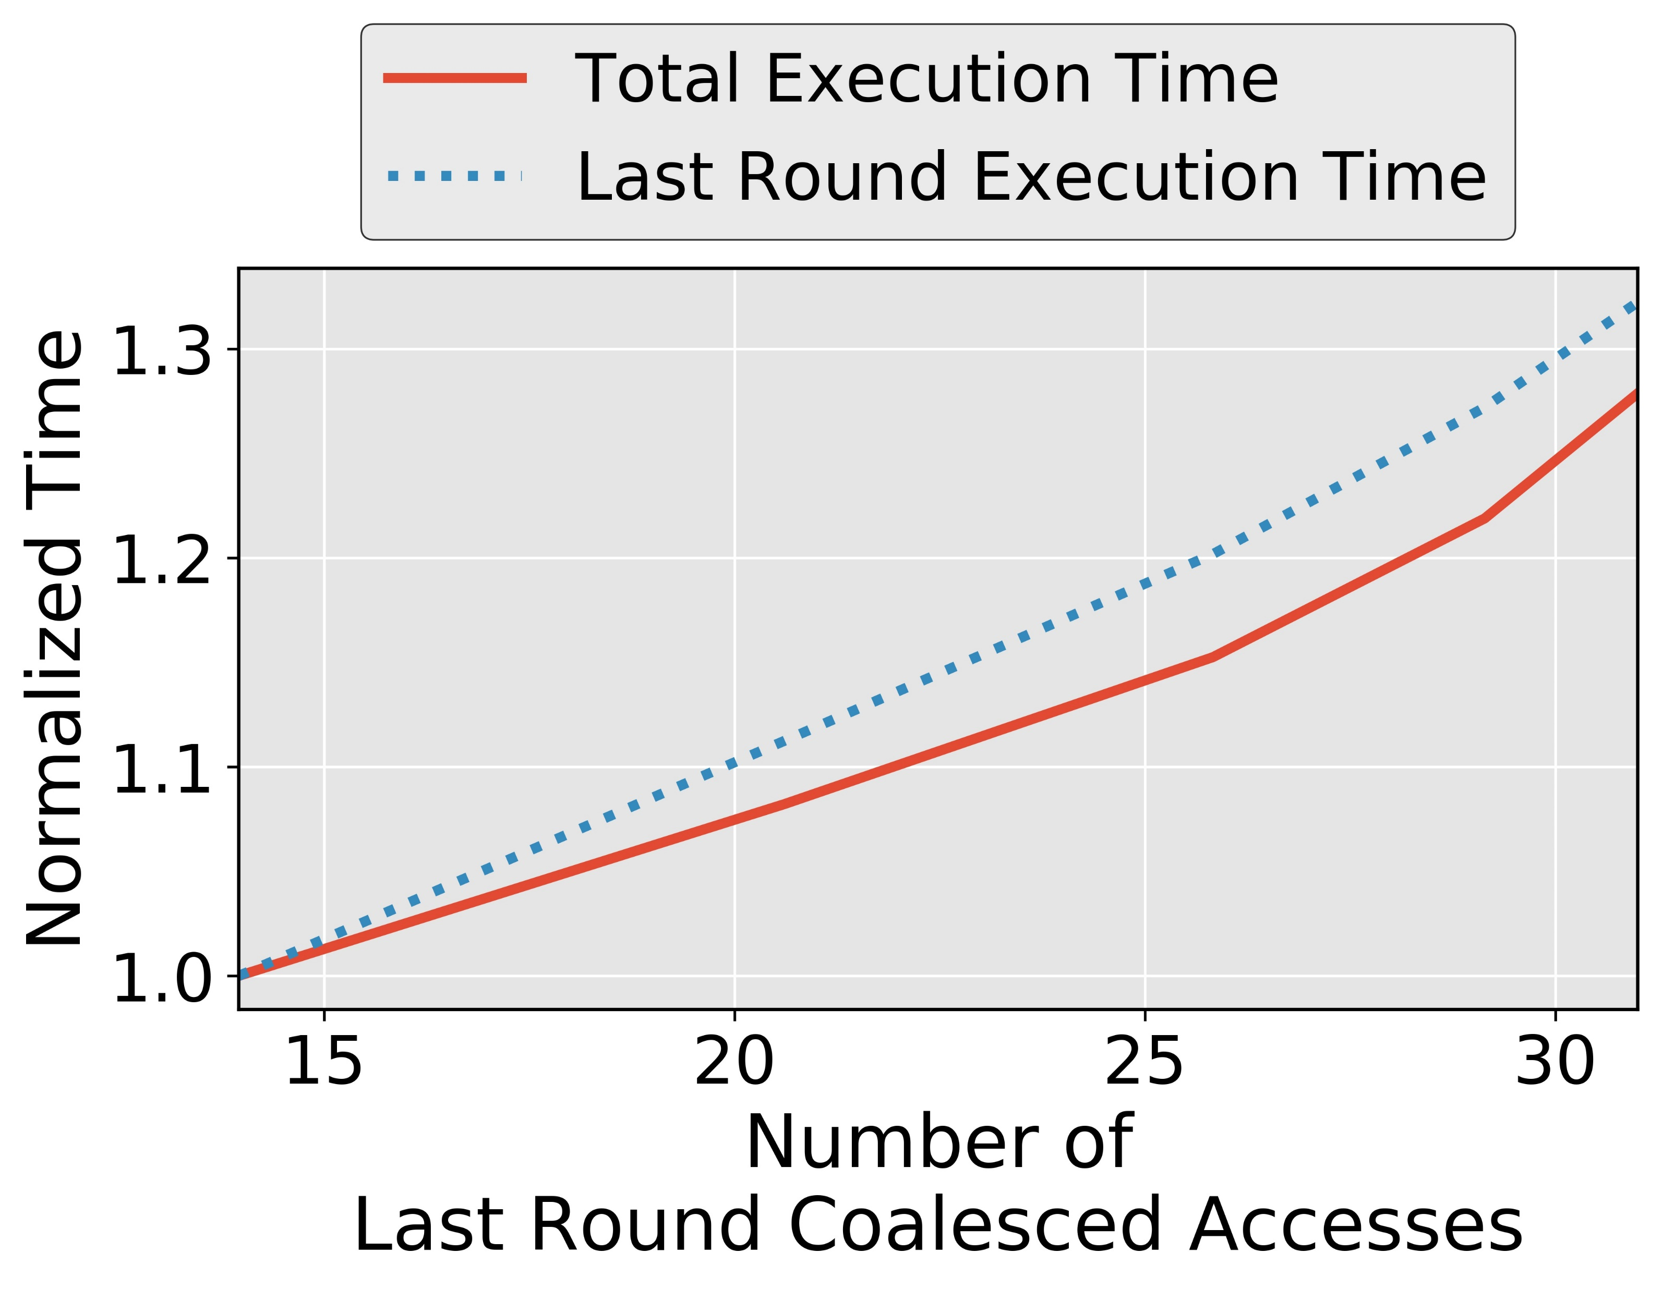
Coalesced Accesses and Execution Time
Associate the number of coalesced accesses with execution time
Notes:
Say on our set-up

Slide 18
Finding the Correct Key Value
Attacker encrypts ‘N’ number of plaintexts over server
Records Ciphertext and Execution time
Recorded
Execution Time
# of Coalesced Accesses
Correlations
Key Guess 0
A_{j}^{0,1}, A_{j}^{0,2}, . . . . , A_{j}^{0,N}
E₁,E₂,...,E_{N}
Corr_{j}⁰
Key Guess 1
A_{j}^{1,1}, A_{j}^{1,2}, . . . . , A_{j}^{1,N}
Corr_{j}¹
.
.
.
.
.
.
Key
Guess α
A_{j}^{α,1}, A_{j}^{α,2}, . . . . , A_{j}^{α,N}
Correct
Key Byte
Maximum Correlation
.
.
.
Corr_{j}^{α}
.
.
.
Key
Guess 255
A_{j}^{255,1}, A_{j}^{255,2}, . . . . ,A_{j}^{255,N}
Corr_{j}²⁵⁵
Notes:
Eliminate the slide transition

Slide 19
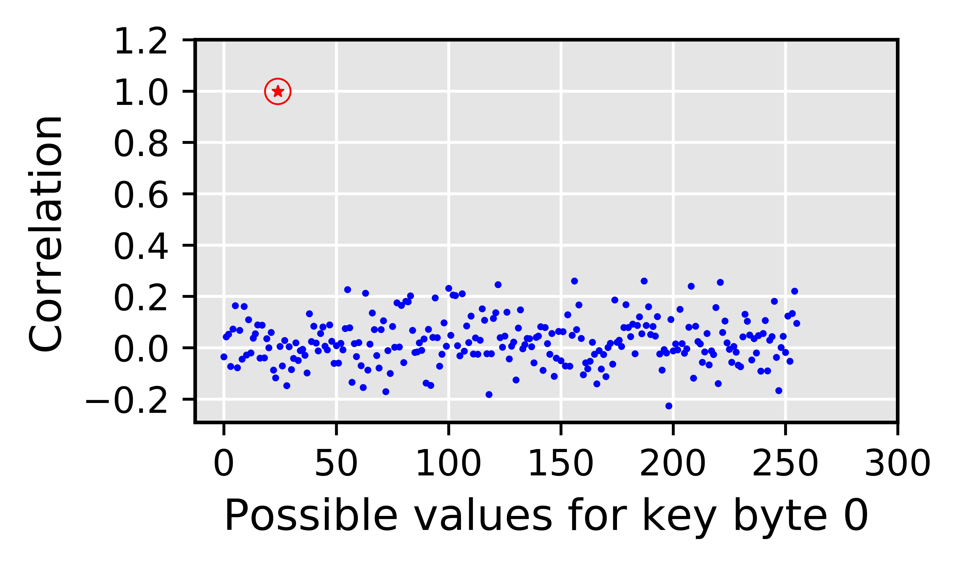
Simulating Timing Attack on our Set-up
Why is Correlation Timing Attack possible?
The baseline attack leverages the deterministic nature of the coalescing mechanism
AES key value affects the coalesced accesses
# coalesced accesses affects the execution time
How to mitigate Correlation Timing Attacks on GPU?
Answer: By making it harder for the attacker to correctly calculate the number of coalesced accesses
Correct guess
Incorrect guesses
Notes:
TODO: Coalescing good for performance and bad for security

Slide 20
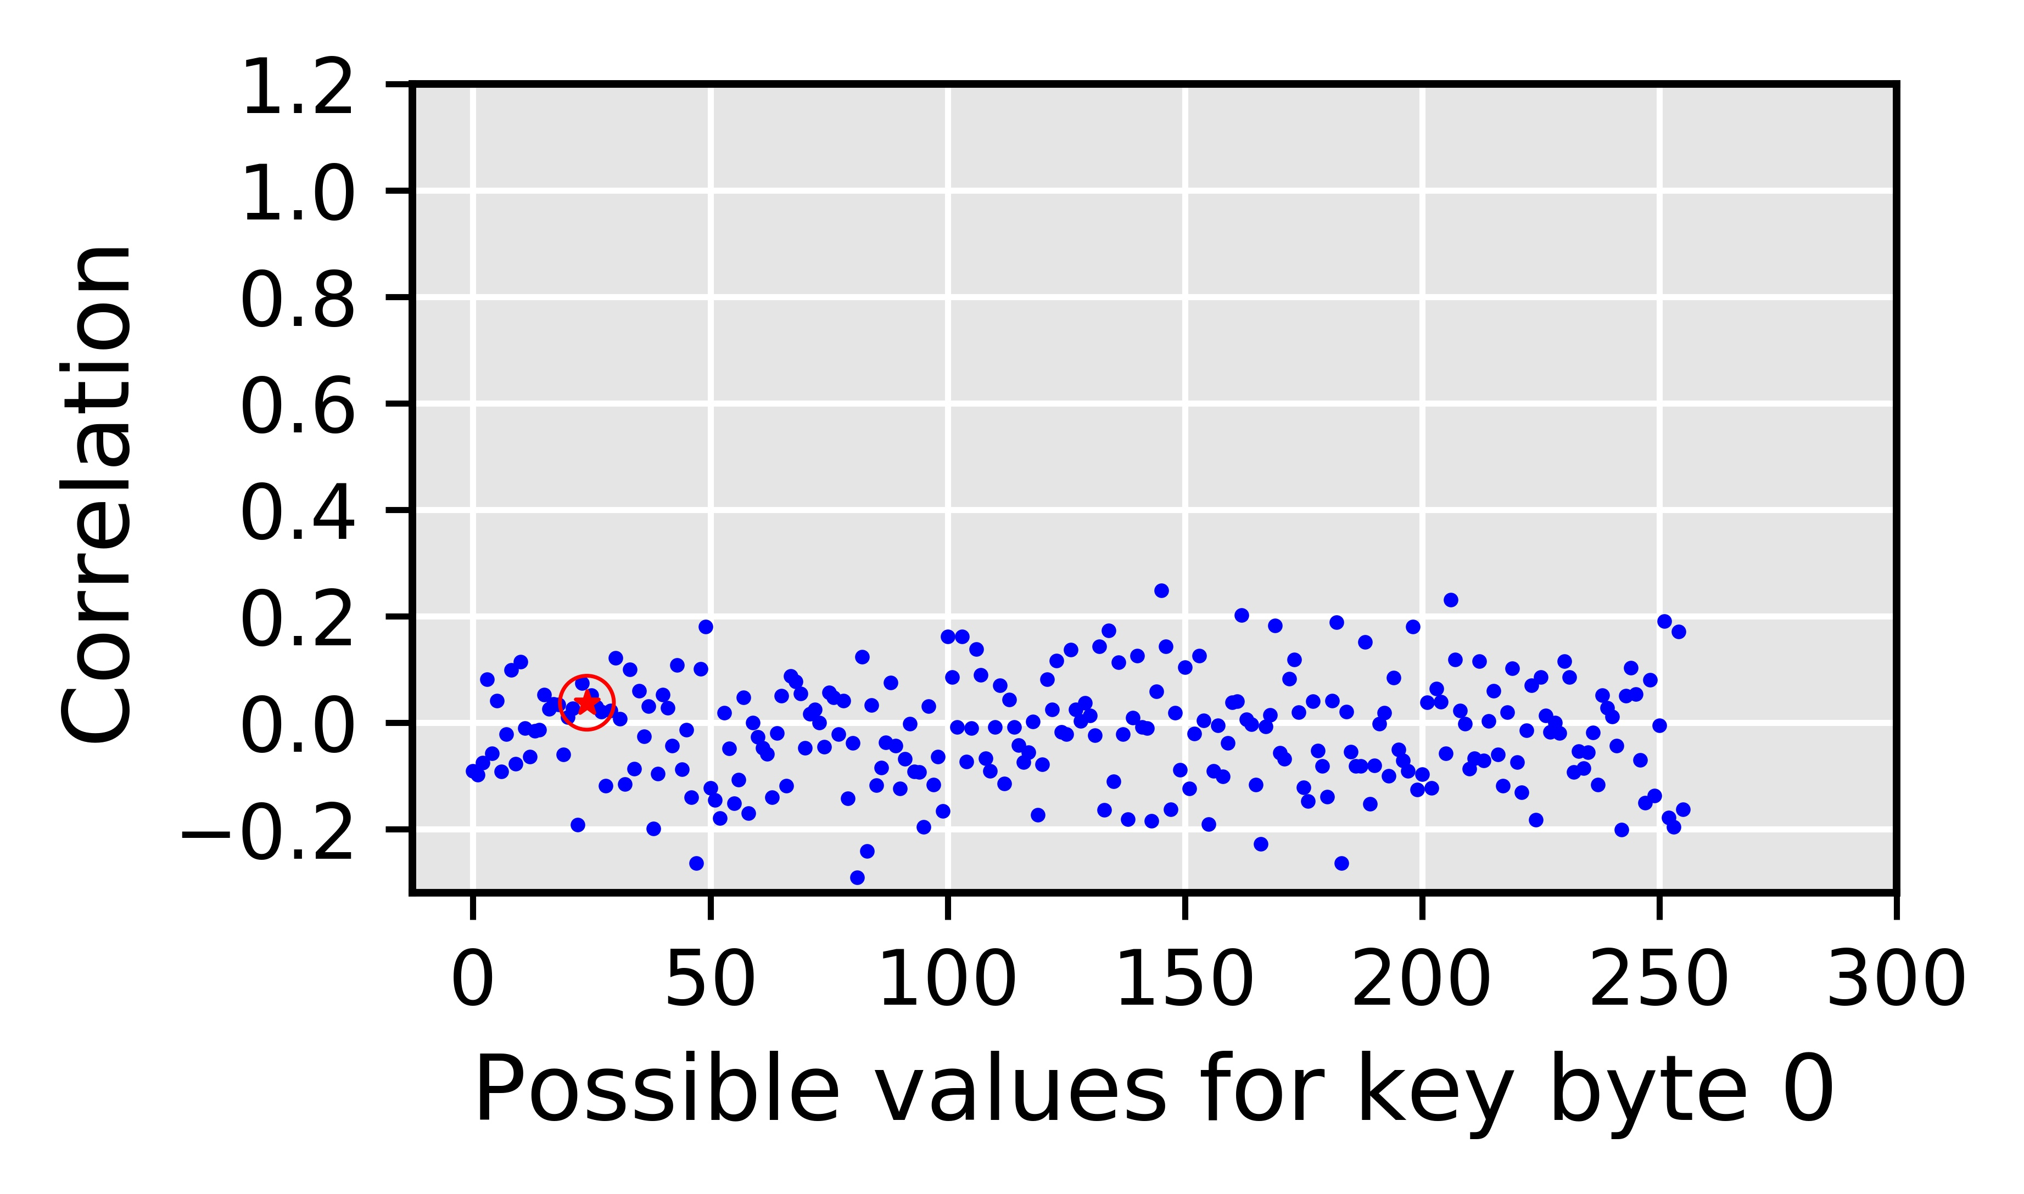
Naïve Solution
Targets the deterministic nature of the coalescing mechanism
Fixed number of subwarps (or subwavefronts)
Fixed sizes of subwarp (or subwavefronts)
Deterministic mapping of the thread elements to subwarps (or subwavefronts)
RCoal to mitigate the correlation timing
attacks
Disable coalescing altogether?
Correlation drops to ~0
Correct key byte is indistinguishable
Up to 178% performance degradation
Degradation increases with plaintext size
Correct guess
Naïve solution is Good for Security, Bad for Performance
Offers no tradeoff

Slide 21
RCoal: Fixed Sized Subwarp (FSS)
DEFAULT: number of subwarps = 1
FSS: number of subwarps = 2
sid = 0
sid = 0
sid = 1
tid = 0
tid = 1
tid = 2
tid = 3
tid = 0
tid = 1
tid = 2
tid = 3
0x00
0x04
0x07
0x09
0x00
0x04
0x07
0x09
Coalescing Unit
Coalescing Unit
0x00
0x01
0x02
0x03
0x00
0x01
0x02
0x03
0x04
0x05
0x06
0x07
0x04
0x05
0x06
0x07
0x04
0x05
0x06
0x07
0x08
0x09
0x0A
0x0B
0x08
0x09
0x0A
0x0B
Notes:
Fixed Size Subwarp eliminates the fixed number of subwarps based determinism.

Slide 22
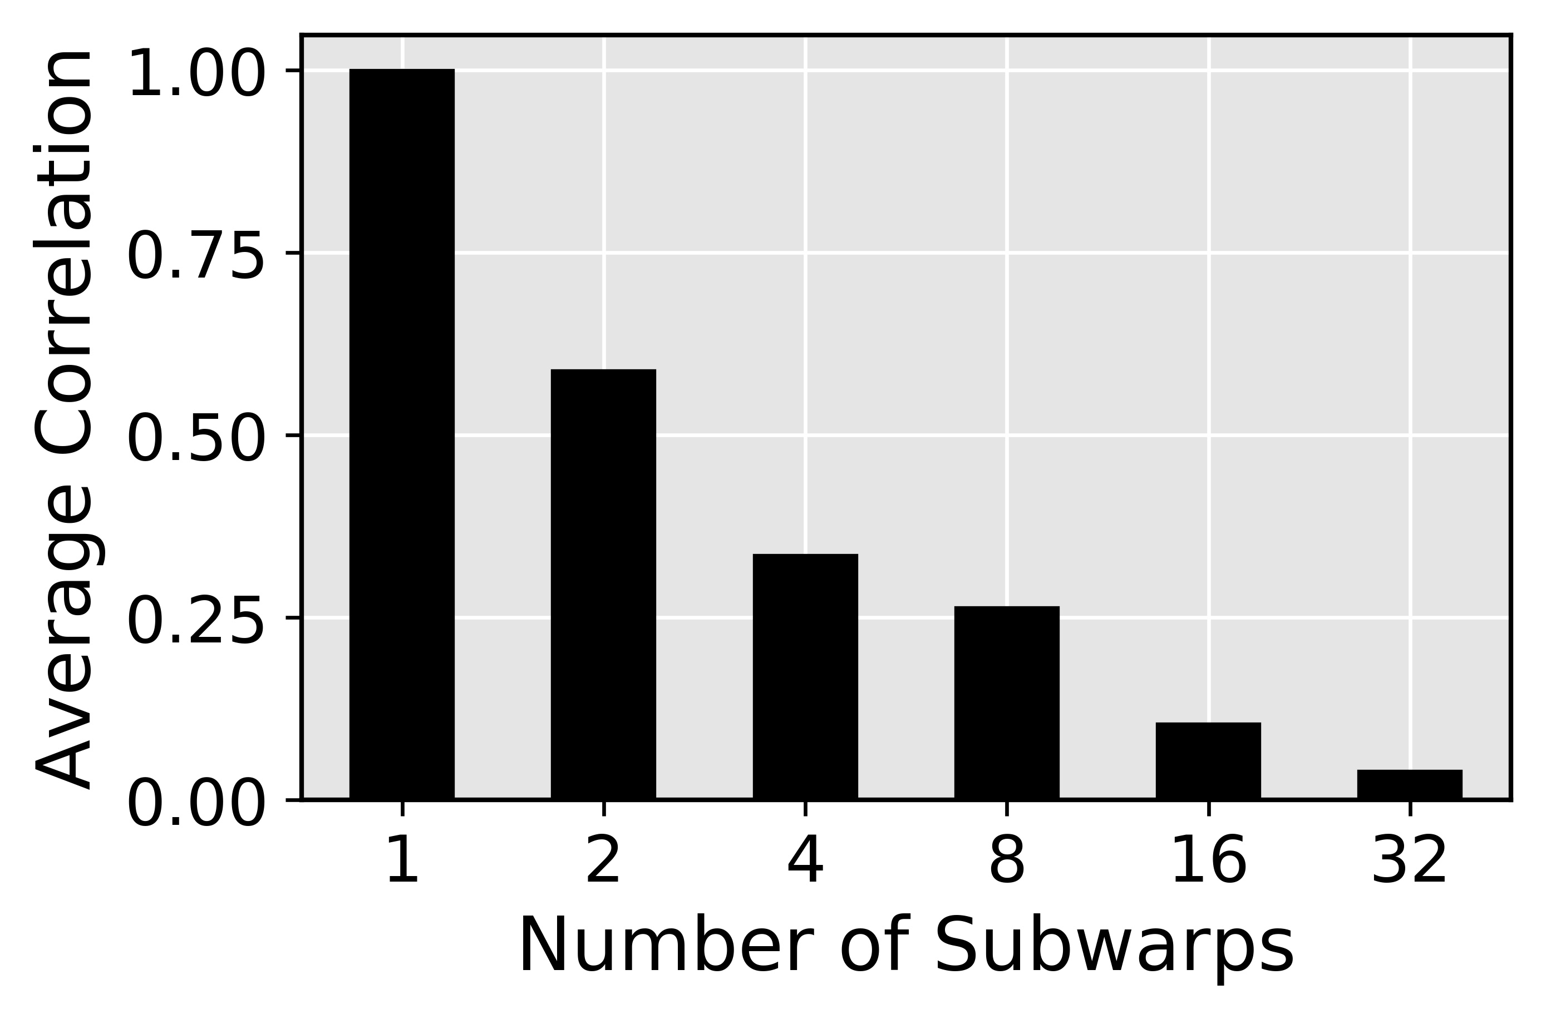
FSS Security against Baseline Attack
Correlation between the number of coalesced accesses and the execution time drops
Correct key byte is harder to find
Improved security

Slide 23
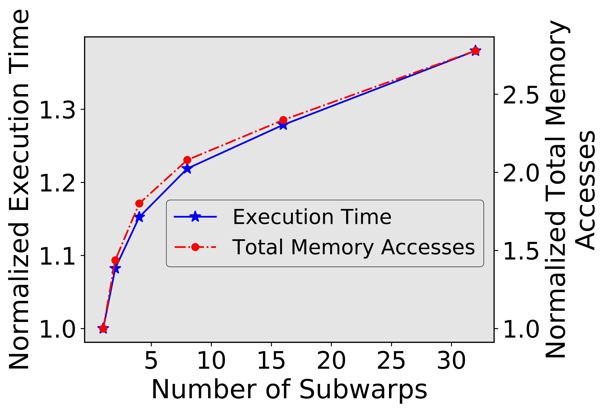
FSS Performance
Memory accesses increase with number of subwarps
Execution time increases with number of subwarps
Performance degrades as number of subwarp increase
Can attacker still recover the AES key?
Notes:
Better transition going into FSS attack

Slide 24

FSS against FSS attack
Attacker can figure out the number of subwarps
Notes:
Why FSS attack?

Slide 25
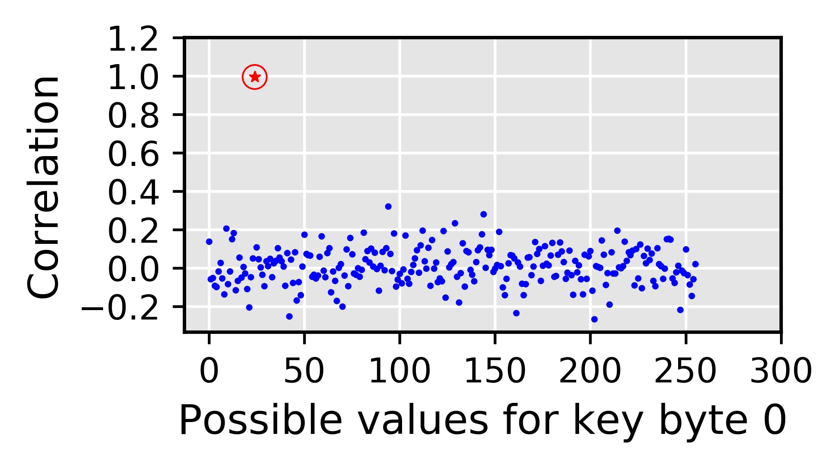
FSS against FSS attack
Attacker can figure out the number of subwarps
Attacker can calculate per subwarp accesses
Correct guess

Slide 26
FSS against FSS attack
Targets the deterministic nature of the coalescing mechanism
Fixed number of subwarps
Fixed sizes of subwarp
Deterministic mapping of the thread elements to subwarps
Attack possible when the attacker can figure out number of subwarps!
Coalescing still deterministic
RCoal to mitigate the correlation timing
attacks

Slide 27
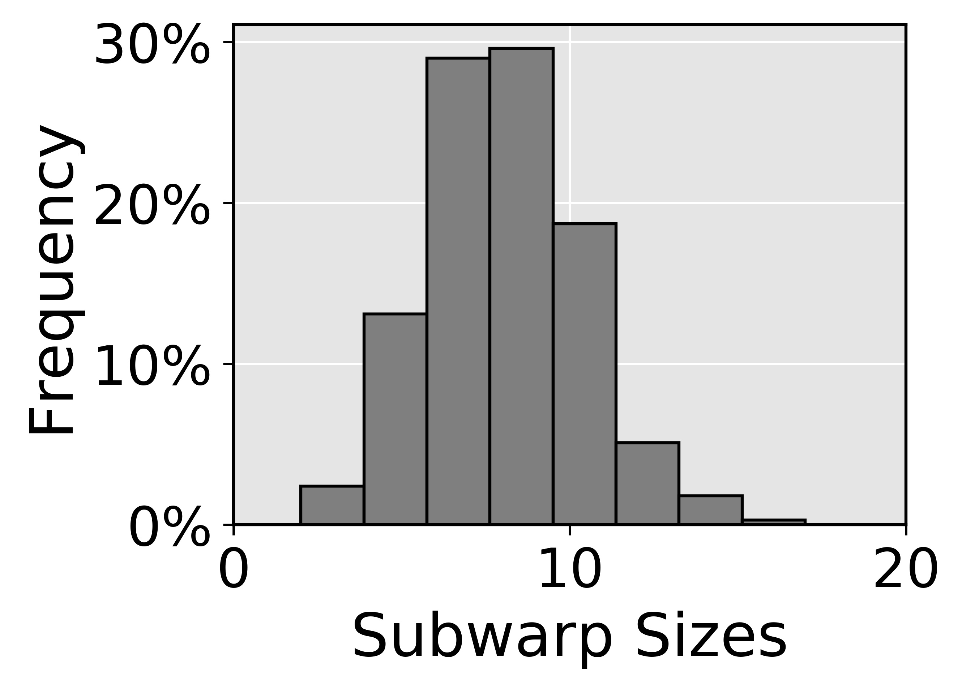
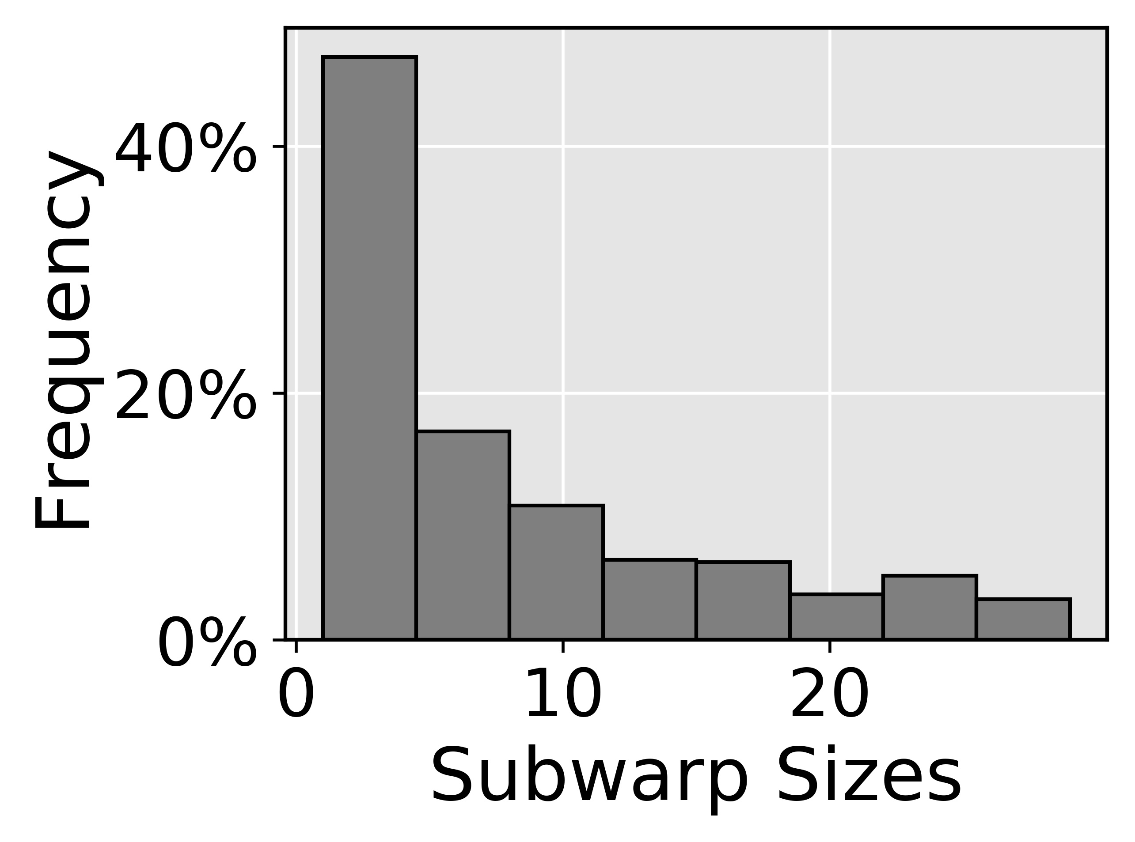
RCoal: Random Sized Subwarp (RSS)
Size distribution
Targets the deterministic nature of the coalescing mechanism
Fixed number of subwarps
Fixed sizes of subwarp
Deterministic mapping of the thread elements to subwarps
We select RSS with Skewed Distribution
RCoal to mitigate the correlation timing
attacks
RCoal to mitigate the correlation timing
attacks
✗
✓
Normal Distribution
Skewed Distribution
Mean of the distribution is same as FSS
Security and performance similar to FSS
Mean of the distribution is different than FSS
Large subwarp offers better coalescing
Improved security compared to FSS
Improved performance compared to FSS

Slide 28
RCoal: Random-Threaded Subwarp (RTS)
FSS: number of subwarps = 2
FSS+RTS: number of subwarps = 2
tid = 0
tid = 1
tid = 2
tid = 3
tid = 0
tid = 1
tid = 2
tid = 3
0x00
0x01
0x06
0x07
0x00
0x01
0x06
0x07
sid = 0
sid = 0
sid = 1
sid = 1
sid = 0
sid = 0
sid = 1
sid = 1
Coalescing Unit
Coalescing Unit
0x00
0x01
0x02
0x03
0x00
0x01
0x02
0x03
0x00
0x01
0x02
0x03
0x04
0x05
0x06
0x07
0x04
0x05
0x06
0x07
0x04
0x05
0x06
0x07

Slide 29
RCoal: Random-Threaded Subwarp (RTS)
RSS: number of subwarps = 2
RSS+RTS: number of subwarps = 2
sid = 0
sid = 1
sid = 0
sid = 1
tid = 0
tid = 1
tid = 2
tid = 3
tid = 2
tid = 0
tid = 1
tid = 3
0x00
0x01
0x06
0x08
0x06
0x00
0x01
0x08
Coalescing Unit
Coalescing Unit
0x00
0x01
0x02
0x03
0x00
0x01
0x02
0x03
0x00
0x01
0x02
0x03
0x04
0x05
0x06
0x07
0x04
0x05
0x06
0x07
0x08
0x09
0x0A
0x0B
0x08
0x09
0x0A
0x0B

Slide 30
Evaluation Set-up
AES-128
Plaintext with 32 lines
GPGPU-SIM
15 SMs, 32 threads/warp, one subwarp per coalescing unit (base case)
GDDR5 Memory with 6 MCs, 16 DRAM-banks, 4 bank-groups/MC
Enhanced Attack Algorithms
Corresponding Attacks

Slide 31
Performance/Security Trade-off
Security
(Lower the better)
Offers Security/Performance Trade-off
Execution Time
(Lower the better)
Notes:
Mention Rcoal in a BOX

Slide 32
Conclusions
We discussed RCoal, a set of three novel defense mechanisms
To mitigate the correlation timing attacks
Randomizes the memory access coalescing
Scales with the plaintext size (analysis in paper)
Theoretical analysis in the paper
RCoal offers a trade-off between security and performance and improves security at a modest performance loss.
Notes:
Try to reduce background and introduce rcoal_score

Slide 33
Food for thought
Improving security at lower performance cost
Can we randomize logic at other parts of the memory hierarchy?
GPU Cache Management
GPU Bandwidth Management (e.g., MSHRs)
GPU Prefetching and Memory Scheduling
Can we leverage software-driven hints?
Only randomize when “security-critical” sections of the code are executing
How do we identify “security-critical” sections? If yes, can we automate the process?

Slide 34
References
RCoal: Mitigating GPU Timing Attack via Subwarp-based Randomized Coalescing Techniques, HPCA’18
A Complete Key Recovery Timing Attack on a GPU, HPCA’16
Grand Pwning Unit: Accelerating Microarchitectural Attacks with the GPU, Oakland’18

